Slide 1
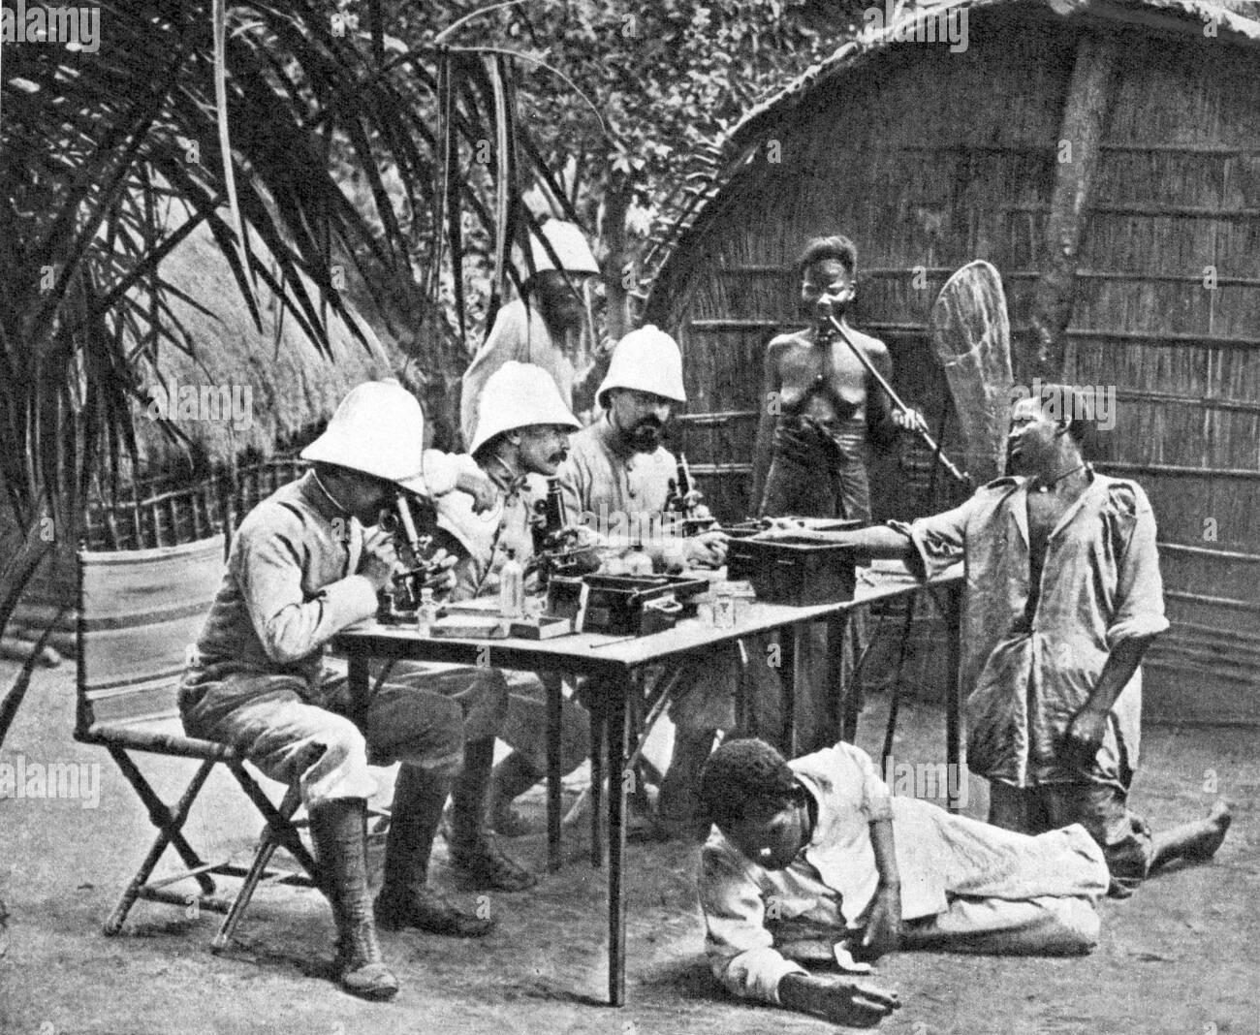
Decolonising Methodology
Dr Rima Saini
CRM4629 Research Strategies 2022/23

Slide 2
Workshop topics
Colonial histories of approaches to research
Decolonising research methods
Deconstructing the quantitative/qualitative divide
Southern and Decolonial Criminology
Critical reflexivity in qualitative research
Data colonialism
Indigenous research
Decolonising quantitative methods: spotlight on survey research
‘QuantCrit’

Slide 3
What is your current experience or knowledge of approaches to research?

Slide 4
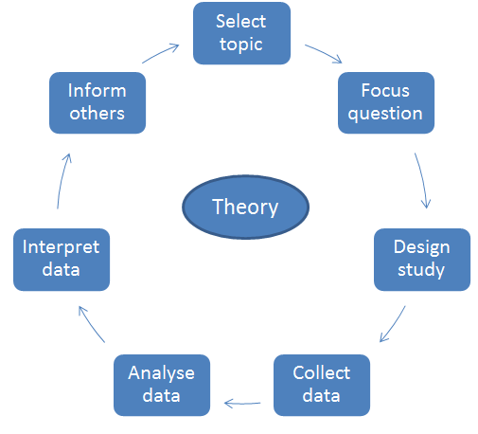
What are the dominant ways we carry out social and criminological research in the UK?
Notes:
Image sources:
https://www.researchgate.net/figure/The-Differences-Between-Positivism-and-Interpretivism_tbl1_326742672
https://www.researchgate.net/figure/Steps-in-social-research-Adapted-from-Neuman-2007_fig1_315564824

Slide 5
As early as 1950, Cesaire wrote about the historical violence and exploitation of colonizing approaches to research, stating: “goitrous academics were tools of capitalism and supporters of plundering colonialism, all of them responsible, all hateful, all henceforth answerable for the violence of revolutionary action” (Cesaire, 1950, pp. 54–55).
Academics were involved in nation-building projects, through race logic and white supremacy, and [perhaps unwittingly] advanced the agenda on anti-Black chattel slavery and the genocide of Indigenous peoples. Cesaire argued that through the process of formulated “thingification” in their research, academics reinforced beliefs that the colonized were nothing more than an object or an animal; and thus, the colonizers are justified in treating them as such (Cesaire, 1950).
(Thambination and Kinsella 2021:4)
Notes:
Thambinathan, V., & Kinsella, E. A. (2021). Decolonizing Methodologies in Qualitative Research: Creating Spaces for Transformative Praxis. The International Journal of Qualitative Methods (20) https://doi.org/10.1177/16094069211014766

Slide 6
What do we mean by ‘decolonisation’ in this context?
Decolonisation in UK higher education is a radical project of institutional transformation that lies in exposing and upturning the colonial underpinnings of our Universities and the inherent Eurocentrism in our teaching, learning and research.
“A colonial curriculum is characterised by its unrepresentative, inaccessible, and privileged nature. Unrepresentative, because it selectively constructs teachings which exclude certain, oftentimes, crucial narratives. Inaccessible, because it consequently prevents many of its recipients from identifying with the narratives construed, whilst appealing to a historically favoured demographic. Privileged, because it ensures the continued participation, comfort and flourish of this select group of people, in both an academic and a wider societal context” (Anne Kimunguyi, Advance HE)
Notes:
Decolonisation of the curriculum – a conversation | Advance HE (advance-he.ac.uk)

Slide 7
What was colonialism?
Political, social, economic, cultural domination by a group of people over another group of people
We often talk about colonialism in the context of European colonialism: the ‘age of discovery’ when Spain, France and Portugal colonised North and South America in the 15th and 16th century, and the colonisation of Africa and South Asian by Britain, France, Belgium, Portugal, Spain and others in the 19th century
Under settler colonialism, indigenous or ‘native’ peoples were killed or forced to assimilate. Resources, materials and human capital was extracted and shipped across the world, building wealth for the colonisers.
There were political and cultural as well as economic dynamics to colonialism including the imposition of new borders, new laws, the abolishment of some cultural practices, and the creation of new racial and caste which placed ‘whiteness’ at the top.
Colonialism permeates most institutions created at the time to maintain empire – this includes academia
Notes:
https://blogs.bmj.com/bmj/2021/08/13/the-legacies-of-colonialism-putting-african-covid-19-vaccination-into-context/

Slide 8
Why do research methods need ‘decolonising’?
Historically, research in colonial contexts was used to measure, control and extract labour and resources from peoples
Methods, particularly, developed from this to create an artificial distance and implicit hierarchy between the researcher and research ‘subject’. This objectivity has often been aligned with ideas around ‘good’ research
Data has been and still is used to justify and reproduce culturally reductive ideas about marginalised groups and societies
The coding and categorisation process implicit in many dominant research methods tends to reproduce often reductive and simplistic group boundaries
Most large-scale research tends to take place in the West or between the Global North and South, through well-funded and often elite organisations and universities. This is tended be seen as the source of most robust academic global ‘knowledge’

Slide 9
What do you think we mean by the hegemony of knowledge?
Who can produce knowledge?
Who owns knowledge?
When and how does research and data become ‘knowledge’?

Slide 10
Destabilising the hegemony of ‘knowing’
Centring the world views and ways of knowing of non-Western communities (indigenous and colonised societies) that have historically been researched in a top-down manner
In an ethics form, the student or the principal investigator and/or the institution ‘owns’ the data. But who owns the knowledge?
‘Ecology’ (Santos 2014) of knowledges – acknowledging the range of ways in which research can and should be carried be out and thus redistributing power to non-Western knowledges
Destabilise bounded ways of knowing, understand how and where they can be dialogue with other, and where power differentials lie (Mignolo and Walsh 2018)
“Giving voice” and “empowering communities” are looked down upon in decolonising research, since it implies that communities are unable to achieve on their own what researchers are able to provide (Bishop, 1998).
Requires respect, responsibility and humility from researchers, as well as acute attention to issues of reflexivity, positionality, and power relations
Integrate reflection on the positionality of the researcher when conducting and writing up research
Challenging the disassociation between people’s lives, and ‘data’. What do we lose in the knowledge gathering process when it becomes ‘data’?
Integrate theory and techniques from non-Western research approaches
Evaluate the limitations of all research approaches to knowledge production
Notes:
Santos, Bonaventura de Sousa (2014) Epistemologies of the South: Justice Against Epistemicide. New York: Routledge
Mignolo, W. D. and Walsh, C. E. (2018) On Decoloniality: Concepts, Analytics, Praxis (Durham, NC, and London: Duke University Press
Bishop, R. (1998). Freeing ourselves from neocolonial domination in research: A Maori approach to creating knowledge. International Journal of Qualitative Studies in Education, 11(2), 199–219

Slide 11
Southern and Decolonial Criminology
Southern criminology aims to democratise knowledge by fully recognizing Global North/Global South hierarchical relations and by resurfacing marginalized knowledge and experiences from the Global South (Carrington et al. 2016).
It is primarily concerned with the careful analysis of networks and interactions linking South and North which have been obscured by the metropolitan hegemony over criminological thought (Carrington et al. 2016)
Much criminological research has tended to neglect analysis of phenomena such as colonial penal practices, crim in post-colonial contexts, indigenous criminalisation and Islamic criminal justice
The vast majority of criminological knowledge production is situated in the Global North’s English-speaking countries, principally the UK and the US, but also Australia and Canada (Dimou 2021)
Maintains that much criminological phenomenon that takes place in the Global South – ecocide, femicide, dictatorship, state terrorism, paramilitarism, assassination, kidnapping – cannot be adequately explained by Western criminological approaches. One reason for this is that it lacks an understanding of the colonial underpinnings of these.
Notes:
Dimou, E. (2021) Decolonizing Southern Criminology: What Can the “Decolonial Option” Tell Us About Challenging the Modern/Colonial Foundations of Criminology? Crit Crim, 29, 431–450
Carrington, K., Hogg, R. and Sozzo, M. (2016) Southern Criminology. British Kournal of Criminology, 56(1), 1–20

Slide 12
Data Colonialism
Data colonialism refers to the colonial and unequal processes and relations involved with organisations or governments gathering ‘big data’, usually digitally, in pursuit of economic and political power
What examples (real or indeed hypothetical) can we think of this?

Slide 13
The advent of ‘big data’ has generated new forms of social relations based on the generation of data points
Big data refers to large volume and complex data sets that are generated by the digital monitoring of e.g. everyday financial transactions e.g. credit card or spikes in demand for e.g. uber cars. It also includes data on crime, medical data, social media data and other types of quantifiable administrative data.
Data colonialism creates a new social order in which big data gathering becomes extractive, surveilling and discriminatory. A recent example is the suspected monitoring of fertility apps in the US to track compliance with new anti-abortion policy. Algorithms drawn from big data can also mean that some types of people are offered e.g. opportunities for social housing where others aren’t
The key across in data colonialism are firms like Amazon, Apple, Facebook, Google, Baidu, Alibaba, who capture social acts that translate them into statistical data that can be used to generate profits
These global flows of data are capitalistic and colonial in that they are supporting the appropriation and control of land, resources and bodies in the Global South. For example, it could help military forces track in which parts of a region experiencing political unrest an insurgence might incur, and engage early with military violence
Notes:
https://eprints.lse.ac.uk/89511/1/Couldry_Data-colonialism_Accepted.pdf

Slide 14
Data collection has long been employed as a technique of consolidating knowledge about the people whose data are collected, and therefore consolidating power over their lives (D’Ignazio and Klein, 2020: 12)
Discuss:
Data does not just ‘exist’ it is constructed. We should not talk, therefore, about ‘data collection’ but ‘data construction’.
Notes:
https://policyreview.info/articles/analysis/what-we-do-data-performative-critique-data-collection

Slide 15
To what extent can we decolonise social science research when the paradigms, procedures and techniques of social research were:
developed by Western scholars in a colonial or postcolonial context, and
we continue use them today in Western universities?

Slide 16
Ways forward: questions to consider before carrying out research
What research do we want done?
Whom is it for?
What difference will it make?
Who will carry it out?
How do we want the research done?
How will we know it is worthwhile?
Who will own the research?
Who will benefit?
Who will have access to the data?
How will the findings be used?

Slide 17
Between 2019 and 2021 People’s Palace Projects - a research centre for social justice at Queen Mary’s University - has hosted a programme of events on Indigenous engagement in research partnerships and knowledge mobilisation, on behalf of the Arts and Humanities Research Council (AHRC) and the Economic and Social Research Council (ESRC)
Notes:
https://peoplespalaceprojects.org.uk/en/projects/indigenous-research-methods/
https://www.youtube.com/watch?v=69vJm8wAvvk&list=PLcz-eAe2LHOaHA360dXHCCwSnVqs4GHB9&index=5

Slide 18
The quantitative/ qualitative divide
Quantitative research seen as ‘objective’ this more valid and reliable
Aligned to positivist approaches to scientific research
Predicated on objectivity and value-free research
Reflexivity and subjectivity assigned to qualitative approaches to research
More readily considers issues of standpoint and researcher bias
Usually entails more stringent ethical considerations due to greater ‘proximity’ to research participants
Historically, quantitative research has been seen as more ‘credible’ usually due to larger sample sizes, more representative data and the use of statistical methods and ‘hard’ data
Decolonising methodology means having a more critical under- standing of the underlying philosophical assumptions, motivations and values which inform research (Smith, 2012, p. 606).
Notes:
Smith, L. T. (2012) Decolonizing Methodologies: Research and Indigenous Peoples. Third Edition. London: Bloomsbury

Slide 19
Critical reflexivity in qualitative research
Thambinathan and Kinsella (2021):
exercising critical reflexivity
reciprocity and respect for self-determination
embracing “Other(ed)” ways of knowing
embodying a transformative praxis
Critical reflexivity framework
(Gilbert and Sliep 2009; Sliep 2016; Sliep and Norton 2016)
Notes:
Thambinathan, V., & Kinsella, E. A. (2021). Decolonizing Methodologies in Qualitative Research: Creating Spaces for Transformative Praxis. The International Journal of Qualitative Methods (20)
https://doi.org/10.1177/16094069211014766
Image source: https://www.researchgate.net/figure/Critical-Reflexivity-Framework-Gilbert-and-Sliep-2009-Sliep-2016-Sliep-and-Norton_fig1_326553521

Slide 20
Colonial and decolonial practices in qualitative research
History of exploitative research towards indigenous communities, particularly in ethnographic and anthropological approaches
Western researchers have traditionally, in postcolonial as well as colonial contexts, been to seen as ‘owning’ knowledge
When there is a clear power relation between who is researching and who is ‘being researched’, the exchange is one-sided.
Researching those in need of help may be predicated on the assumption that the researcher will provide assistance. Or, it can be seen as exploitative. This raises ethical questions around duty of care towards research participants
Are we discoverers of knowledge? Interpreters? Or learners? Should we be asking questions and listening, more so than seeking to find answers?
How does the academic framework prioritise research outcomes in relations to findings and impact, rather than outcomes for the communities being researched?
Relational approaches to qualitative research advocate co-productive research with and for indigenous / marginalised communities

Slide 21
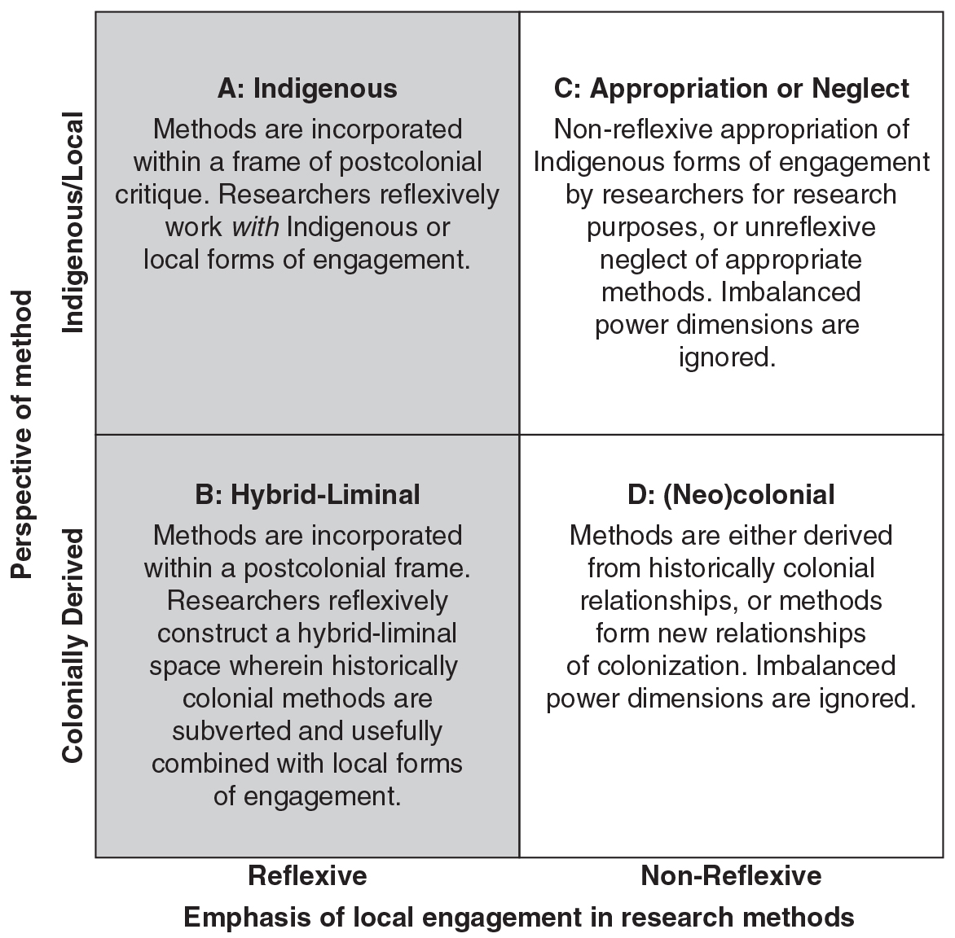
Reflexive vs non-reflexive and local/indigenous vs colonial approaches to research methods
Notes:
Source: The SAGE Handbook of Qualitative Business and Management Research Methods: History and Traditions (2017)

Slide 22
Case study: decolonial approaches to doctoral research on IPV amongst Aboriginal Australian women (Emma Buxton-Namisnyx)
Critically examines, from a post-colonial perspective, the relationship between the State and inter-personal violence
Argues that gender violence analysts under-theorise the relationship between State power and crime
Importance of analysing intersectionally – how does gender, race and colonialism impact on Aboriginal women’s experiences? Without using the White population as a comparison point
Engages in scoping work with community elders and community service providers to discuss the research design and communication plan, and understand how to centre Indigenous narratives
Giving research findings back to the participants for them to use in political advocacy to promote their own rights
Notes:
Decolonising my doctoral research | Oxford Law Blogs

Slide 23
In quantitative research
Social survey research often reduces diverse identities, experiences and complex views into pre-defined categories
Precludes meaningful interaction with research participants. Distance only enhanced if using secondary quantitative data (survey data that has already been collected and processed by a research body)
Colonially, was used not just to survey/measure populations but to control and impose new identities on them
Attention to the axiological dimensions (the ethical judgements made during research) of quantitative research entails putting aside foregone conclusions about the validity and reliability of quantitative data and considering other ways that the worth of research might (also) best be judged
How can knowledge be respectfully and meaningfully co-produced with marginalised communities or populations of interest?

Slide 24
Standard Australian quantitative practice promulgates Indigenous data as benign numerical summaries presenting a picture that is objectively real. Not so. The ontological frame is a presumption of pejorative Indigenous racial/cultural difference and a norm of Indigenous deficit. Or more simply, our assertion is that the quantitative research questions asked are shaped by the askers’ ontological frame, which extends to the results generated
(Walter and Anderson 2013: 105)
Notes:
Walter, M. and Andersen, C. (2013) Indigenous Statistics: A Quantitative Research Methodology. London: Routledge

Slide 25
Case study: the criminalisation of the hijra community in India
In the 1860s and 1870s, colonial police officials in British-ruled northern India drew up “registers of eunuchs,” the British term for Hijras (male bon people with a feminine gender identity and/or transgender women) which present day Hijras find offensive.
These registers recorded an individual’s name, age, place of residence, districts they travel to, age of castration, castrator (if known), and livelihood.
During the nineteenth century, all sorts of economic transactions and categories of people (especially criminalised and marginalised ones) were recorded on registers, as the British sought to understand, classify and control India.
In 1871, the elimination of the Hijra community was formalised through the 1871 Criminal Tribes Act. Part I designated certain communities as “criminal tribes” while Part II targeted ‘eunuchs’. primarily Hijras
Hijras still exist in present-day India but are still criminalised, for example through anti-begging laws, and often reject inclusion in formal registers or certification of their identity.
Notes:
Source: https://www.historyworkshop.org.uk/registers-of-eunuchs-in-colonial-india/

Slide 26
How to think sensitively and reflexively in survey research
The ‘messiness’ of data both must be acknowledged. The often non-linear ways in which we choose to measure, recode and input a particular demographic characteristic or social phenomenon in a statistical model will constrain the conclusions we can draw
Individual reflection is important on the impact of the researcher’s own positionality on variable choice, the types of analyses undertaken, and their interpretation is as important in quantitative research
With secondary survey data, information in the technical report on survey methodology and approach as well as variable choice and framing should be critically appraised, not just in relation to validity and comprehensiveness of measures but how well different groups are represented, and the extent to which marginalised/minority groups might be able to self-define

Slide 27
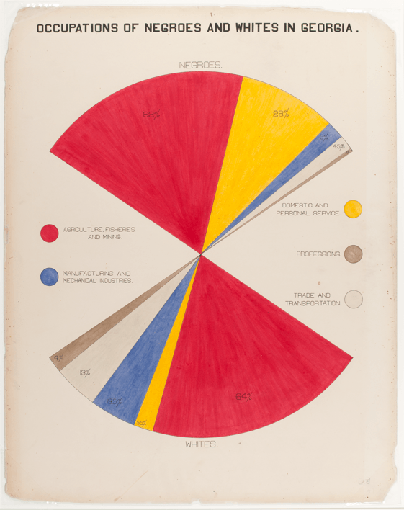
How can statistical research be accessible and emancipatory?
Notes:
Du Bois, W. E. B. (1900) The Georgia Negro Occupations of Negroes and whites in Georgia. [Photograph] Retrieved from the Library of Congress, https://www.loc.gov/item/2005676812/.
https://www.release.org.uk/publications/numbers-black-and-white-ethnic-disparities-policing-and-prosecution-drug-offences

Slide 28
QuantCrit and understanding ‘Black underachievement’ with statistics
The educational achievement gap occurs when one group of students significantly outperforms another group
Statistical data on test scores and educational outcomes have long been used to evidence differences in achievement by ethnic/racial group
Although claims like ‘Nearly a third more African American men are incarcerated than in higher education’ draws attention to systematic racism in the criminal justice and higher educaton system, they also ‘stigmatize and stereotype Black students and are often accepted at face value without interrogation’ (Young and Young 2022: 383).
QuantCrit is a movement to engage in and communicate statistical research which is uplifting and transforming for communities of colour, and speaks to the structural and systemic nature of racism
Young and Young (2022) advocate against using ‘White’ as the reference or comparator group in statistical analysis as it reproduces a racial hierarchy of superiority
Statistics that advance social justice will look at nuance – the way in which categories are formed, the relative size of effects between groups, where differences lie between groups that aren’t set against the White comparator group – as well as data limitations
Notes:
Jamaal Young & Jemimah Young (2022) Decoding the data dichotomy: applying QuantCrit to understand racially conscience intersectional meta-analytic research, International Journal of Research & Method in Education, 45:4, 381-396, DOI: 10.1080/1743727X.2022.2093847

Slide 29
Decolonising in the methods classroom – example: reflexive and critical thinking in survey design
How do we / others frame ‘race’ in a social survey? ‘White’, Black’, ‘Asian’, ‘Mixed’, ‘Other’ ?
Are these identity questions reflective of different possible modes of self-identification for the population / groups we’re interested in?
Do these variables sit well with us, and our positionalities? How would we feel about filling in this survey?
Why do we frame these identities in such a way? What are the historical roots of social survey design and categorical thinking? How is survey design thus political?
What considerations do we need to make in terms of accessing survey respondents? Re. language, access, time, compensation, (dis)ability?
Why is it important to collect this data? What will it and won’t it tell us?
How will be analyse the statistical data? Will we be critical of it as well as attempt meaningful analysis with it?
Can we engage with those we’re surveying to help us understand the dimensions and critiques of these questions?

Slide 30
Name a key takeaway from this workshop that sticks in your mind…

