Slide 1
Using case studies in your assignments
Identify the purpose of using case studies
Apply critical questions to a case study
Integrate case studies and other reading

Slide 2
What is a case study and why do you use them?

Slide 3
What is a case study and why might you use one?
A detailed and specific example of a wider issue or topic – a real life example of a situation, problem or person to draw a more general conclusion from.
Can come from your own experience, from your tutors or from your reading.
A chance to look up close at an example to deepen your understanding of a topic – great way of showing your understanding to your tutor.
Gives you evidence to support your points.
Shows you can apply theory and other information from your modules to a specific example.

Slide 4
You need to think about your case in detail and then look at how it fits into the bigger picture.
Ask yourself: What does it mean? What does it tell me about X?
This means you think about it critically.
Can you explain what ‘thinking critically’ mean?

Slide 5
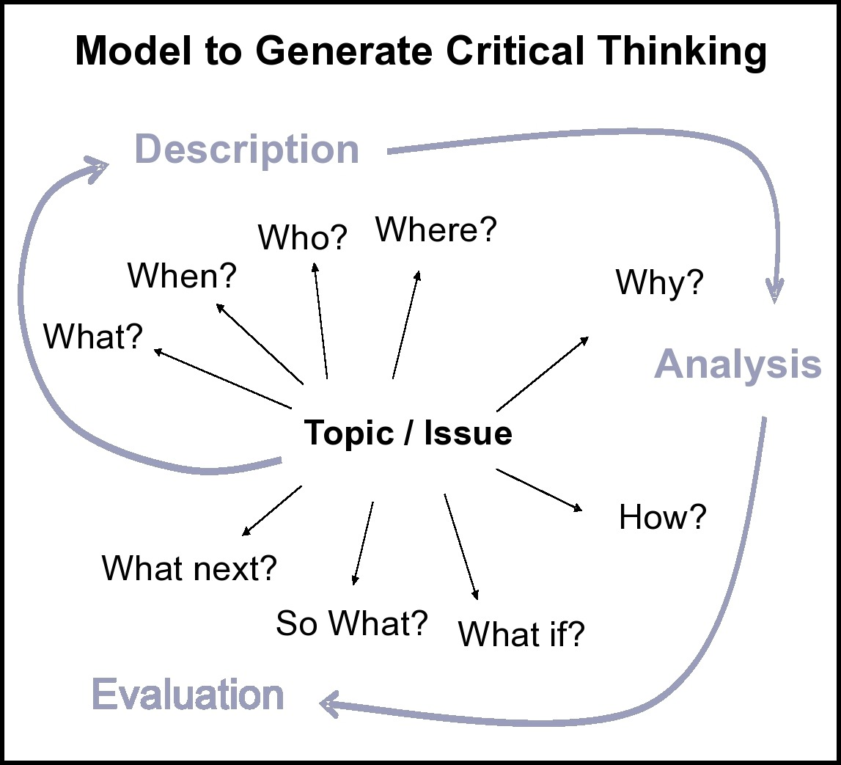
Critical analysis is…
Thinking about all the elements of a topic
Not taking information at face-value
Thinking about context/conditions
Considering an issue in different ways
Analysing and evaluating information, before making a judgement
Asking and answering questions

Slide 6
So, question everything about a case study. Have you ever considered these questions? When and why?
What are the key facts/issues/problem?
What is being said or reported? What is maybe not being said or reported?
Why has this happened?
How does this remind me of the theories, concepts and other information I have learnt about? How do they help explain what is happening in the case?
So what does this case tell me about the whole topic of X?
What if solution X or action Y was used in response?
What could be the next step or recommendation?

Slide 7
You have some of these key critical questions and a short case study. Read the case study and, in groups, add your thoughts to each question.

Slide 8
To make greater sense of it, relate it to the things you have read or learnt about.
What/who | What’s happened/needs analysing? | Possible causes? | Reading (theories, information, policies etc) | Possible actions/ recommendations
26 year old woman Bangladesh to UK 3 yrs Gave birth 1 month Limited English Financial probs | Unhappy Lacks energy Lacks interest in baby No known MH issues | Psychological: Post-natal depression? Isolated?
 | Lacks energy Lacks interest in baby Stomach pains No physical abnormality | Physiological: Anaemia? Vit D?
 | Husband and his family seem dominant | Social/cultural: Marriage?

Slide 9
What/who | What’s happened/needs analysing? | Possible causes? | Reading (theories, information, policies etc) | Possible actions/ recommendations
26 year old woman Bangladesh to UK 3 yrs Gave birth 1 month Limited English Financial probs | Unhappy Lacks energy Lacks interest in baby No known MH issues | Psychological: Post-natal depression? Isolated? | Symptoms of post-natal depression/poss treatments Policy on child safety in such cases? | Recommend counsellor Cognitive behaviour therapy? Refer to social services?
 | Lacks energy Lacks interest in baby Stomach pains No physical abnormality | Physiological: Anaemia? Vit D? | Symptoms and pathology of anaemia and vit D deficiency | Vitamin D supplements/iron tablets and diet
 | Husband and his family seem dominant | Social/cultural: Marriage? | Policy on non-English speaking patients Norms of Bangladeshi families BUT aware of unconscious bias: policy and literature on inclusivity | Independent translator to get fuller picture Social services referral?

Slide 10
What do you think is the most important thing to remember when you're using a case study?

